Slide 1

AA 5750 – Contemporary Issues in Analytics
How To Train your Neural Networks

Slide 2
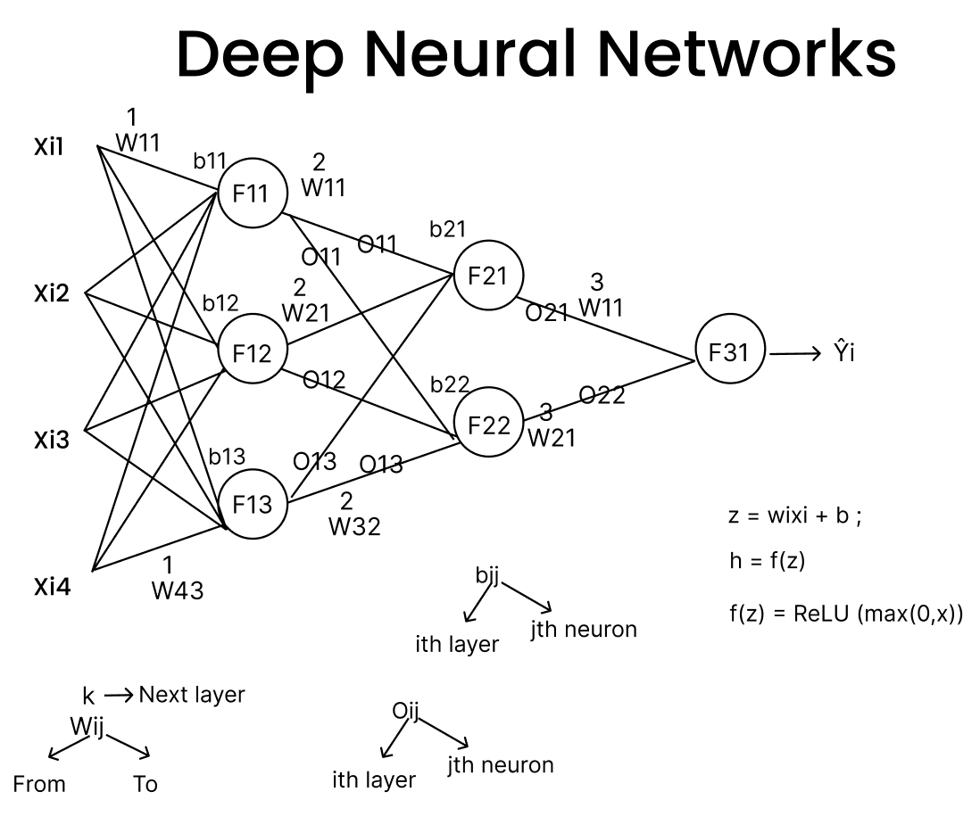
Training an MLP
Define network architecture.
Initialize weights and biases.
Forward propagation: compute activations layer by layer
Compute loss using a differentiable loss function
Backpropagate errors to compute gradients.
Update weights using an optimizer.
Iterate over data multiple epochs until convergence

Slide 3
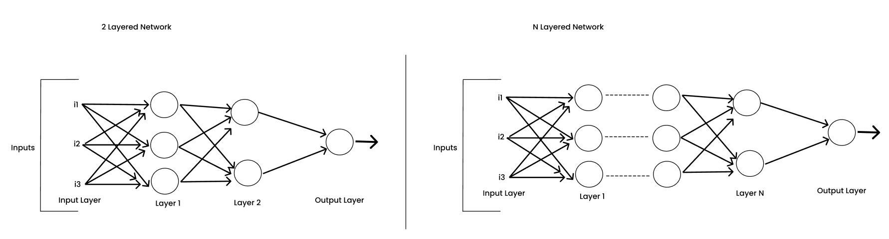
Deep Neural Networks - Architecture
Classification (categorical output) vs Regression (continuous output) → determines final activation & loss.
Choose number of layers & neurons. Based on complexity of patterns. More layers → hierarchical representation learning.
Initialize weights & biases properly.
Select activation functions intelligently.
Decide optimization & training strategy.
Regularization & normalization strategy.
Hyperparameter choices.

Slide 4
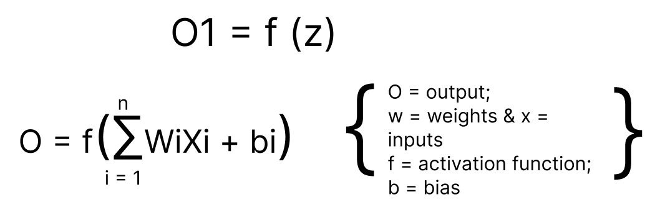
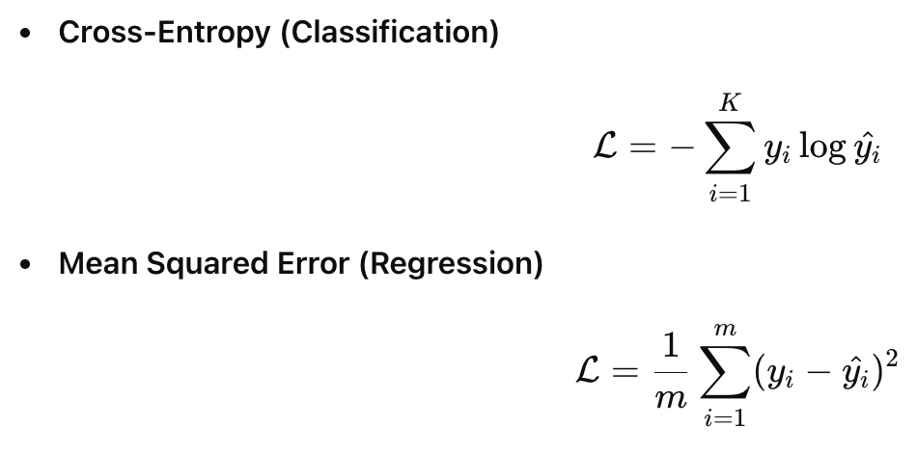
Forward Propagation
Combines previous layer’s outputs using weights
Adds bias for shifting activation space
Applying Activation Function:
Introduces non-linearity → enables complex decision boundaries.
Define Loss Function for the Network:

Slide 5
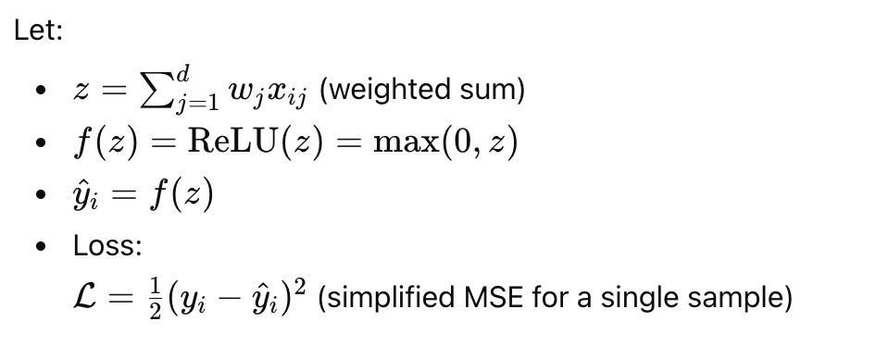
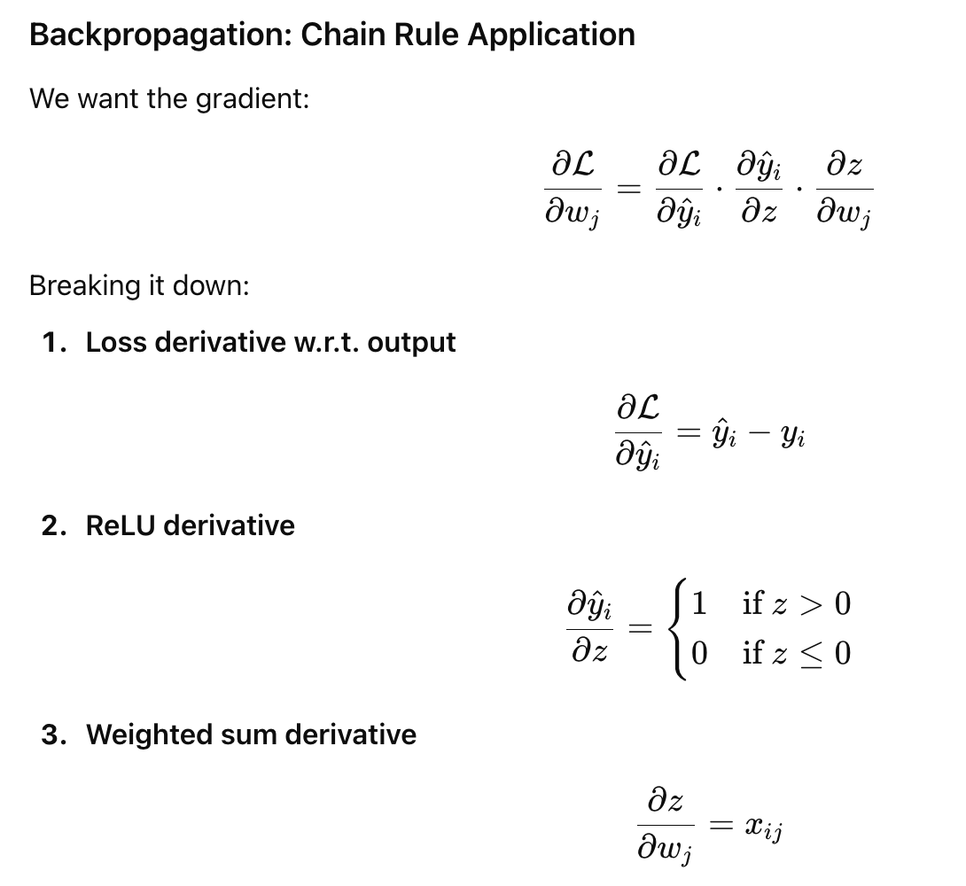
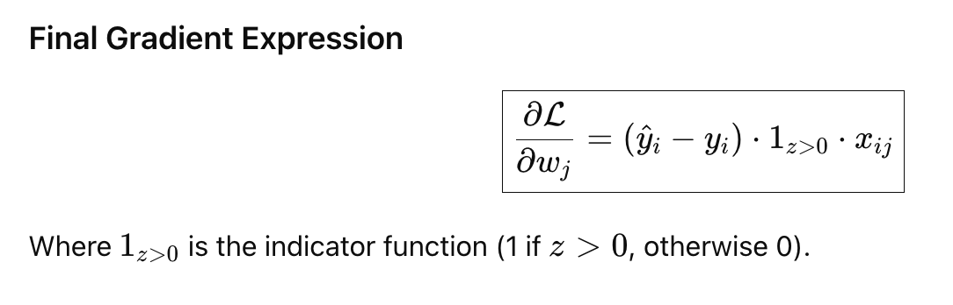
Backward Propagation – Optimizing Weights
Uses chain rule to propagate error from output → input.
Computes partial derivatives w.r.t. each weight and bias.
Gradients show how much each parameter influenced error.
Weight updates move in the negative gradient direction
Applied layer-by-layer in reverse of forward pass.
Central to deep learning because weights are learned end-to-end.

Slide 6
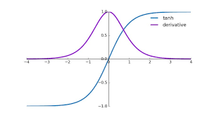
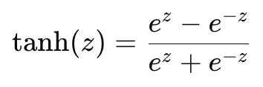
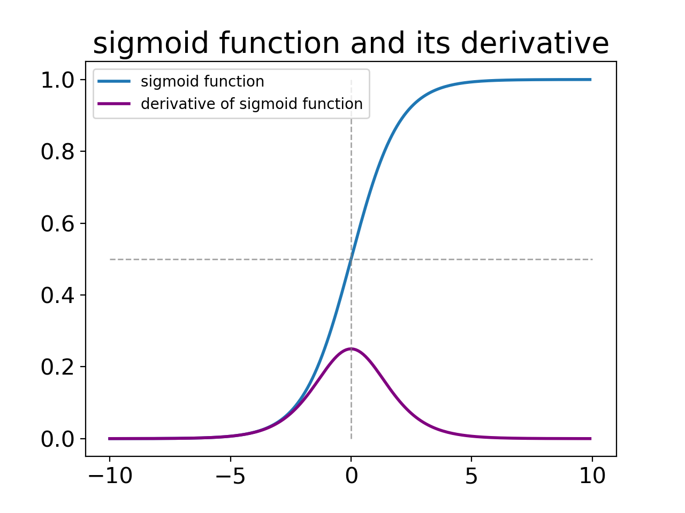
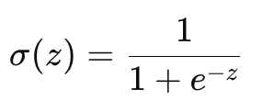
Why Do Sigmoid, Tanh Fail in Some MLP Training Cases?
These activation functions give neural networks non-linearity, but each comes with mathematical limitations that can cause training failures in practice.
Sigmoid:
What it is: Maps any real value into (0, 1) — used for probabilities.
Why it fails:
Vanishing gradients For large |z|, derivative ≈ 0 → backprop stalls in deep layers
Not zero-centered Causes zig-zagging updates → slower convergence
Saturates extremely quickly → hard to train deeper networks
Poor representation of negative values → limited expression power
Tanh:
What it is: Zero-centered mapping into (-1, 1) Better than sigmoid in hidden layers.
Why it fails:
Still saturates for large |z| → gradient ≈ 0
Suffers from vanishing gradients in deep networks
More expensive to compute
Can produce exploding activations if weights not initialized properly

Slide 7
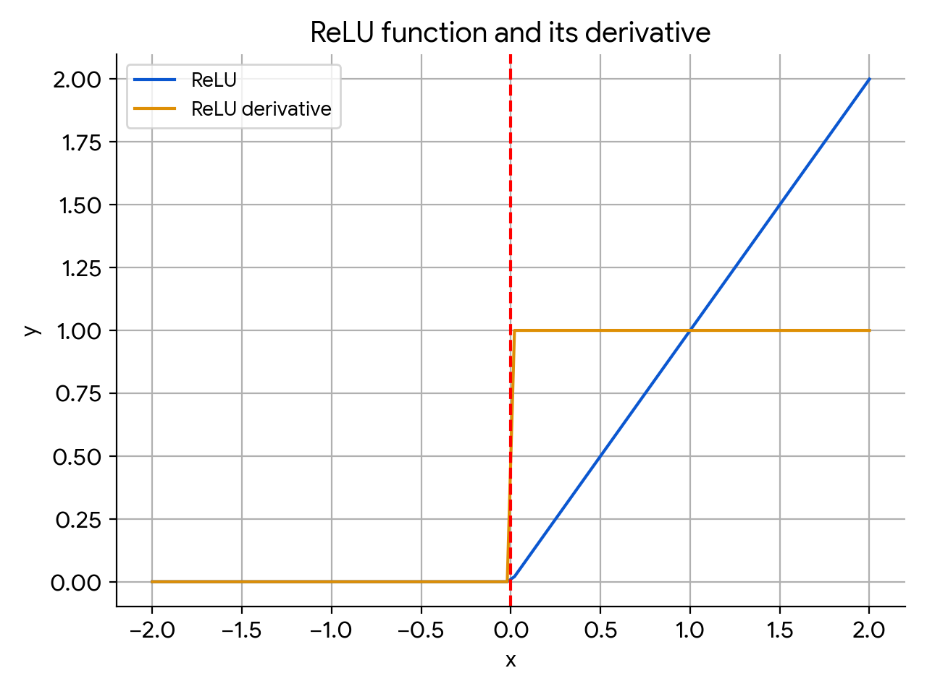
ReLU – Rectified Linear Unit
What is ReLU?
Rectified Linear Unit activation: ReLU(z)=max⁡(0,z)
Introduces non-linearity while being computationally cheap
Allows sparse activations, only positive signals pass through
Reduces vanishing gradient issues seen in Sigmoid/Tanh
Works extremely well in deep neural networks (MLPs/CNNs)
Common default activation in hidden layers due to fast convergence
Where ReLU Fails
Dying ReLU problem: neurons can get stuck outputting zero permanently [Saddle Points].
Not zero-centered → can slow optimization due to biased gradients
The function is non-differentiable at zero.
Gradient is zero for all negative inputs → information lost on negative side.

Slide 8
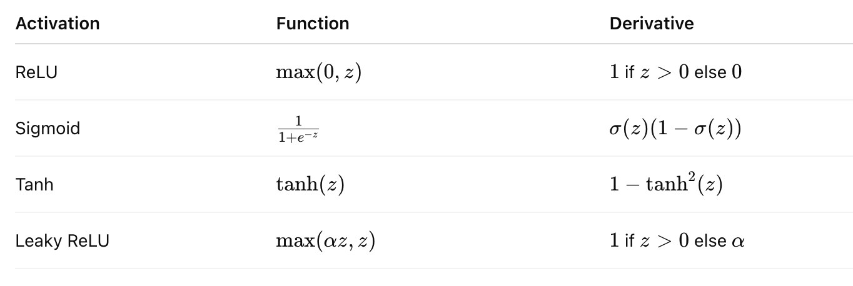
Activation Functions & Derivatives
Activation Functions should be differentiable.
Should be easily differentiable.
And should be expressed in terms of themselves.

Slide 9
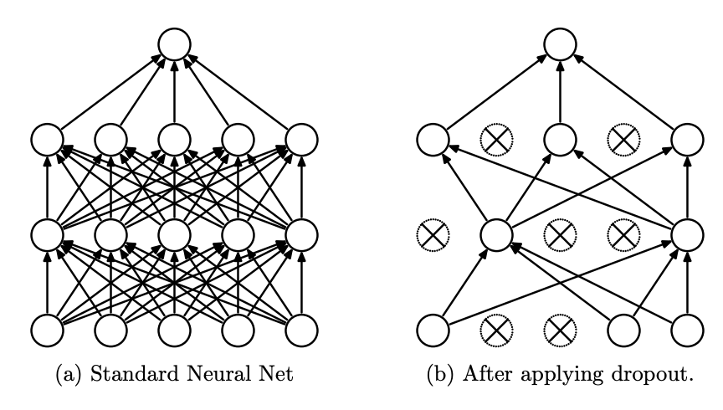
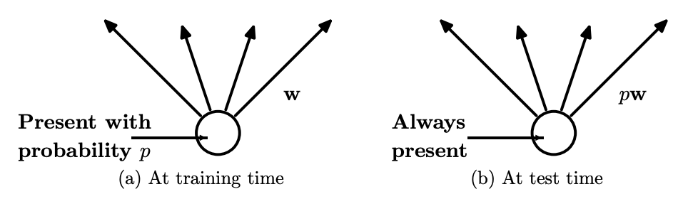
Dropouts
Randomly turns off neurons during training (e.g., 20–50% dropped) to reduce reliance on specific weights.
Acts as regularization, preventing overfitting by forcing distributed representations.
Makes the network robust to noise and improves generalization.
Cheap and easy to implement commonly used in fully connected layers.
During testing, dropout is disabled and weights are scaled to compensate but a probability will be multiplied with w [pw] because with that probability the networks seeing those connections.
Not ideal for convolutional layers or batch-normalized models, can disrupt learned feature activations.

Slide 10
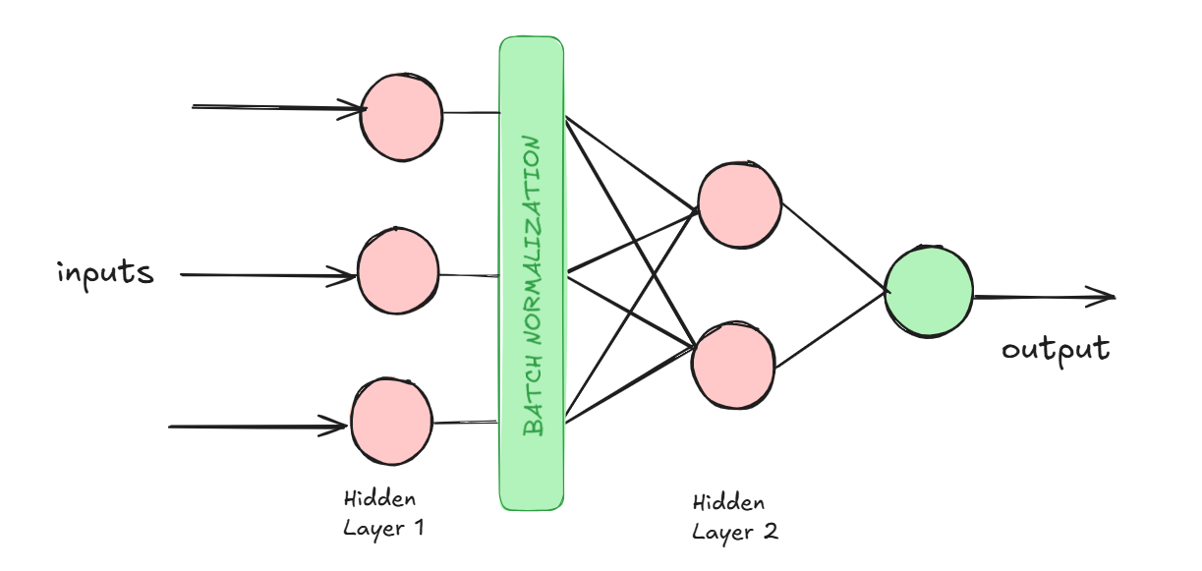
Batch Normalization
Normalizes layer activations per mini-batch to zero mean, unit variance.
Stabilizes gradients, allowing higher learning rates and deeper networks.
Reduces internal covariate shift → accelerates training.
Acts as regularizer, sometimes reducing need for dropout.
Learns scale and shift parameters so model capacity is preserved.
Fails in very small batches or sequence models statistics become unstable → alternatives like LayerNorm used.

Slide 11
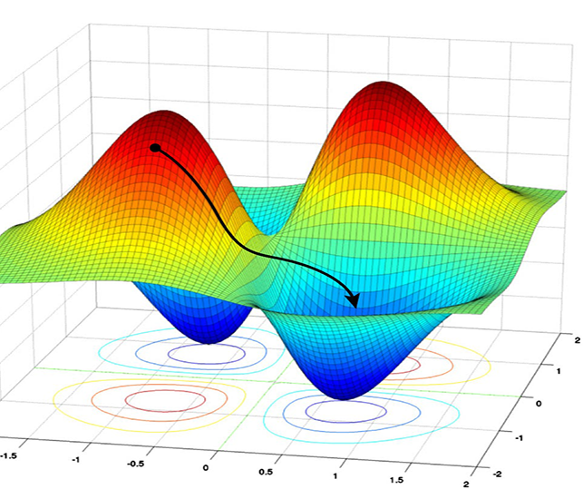
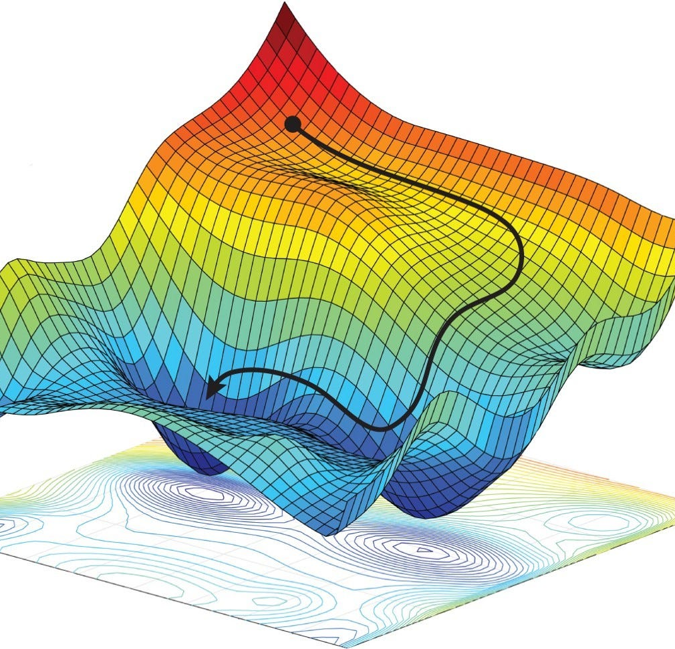
Optimization
What is Optimization?
The process of minimizing the loss function by adjusting weights and biases.
Uses gradient information from backpropagation to move parameters in the best direction.
Good optimization leads to faster convergence and better generalization.
Helps navigate issues like saddle points, local minima, and plateaus.
Affects model ability to escape poor regions of loss landscape.
Choosing a poor optimizer leads to slow, unstable, or stuck training.
Convex & Non-Convex Functions. Non-Convex functions are seen in these MLPs.

Slide 12
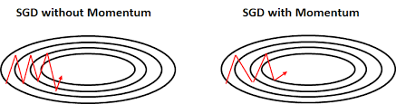
Stochastic Gradient Descent
Updates parameters using small random batches of data.
Simple and memory-efficient → strong baseline optimizer.
Good generalization performance vs complex optimizers.
Can be very slow near minima due to noisy updates.
Struggles with ravines and curved loss surfaces.
Requires careful learning rate tuning.

Slide 13
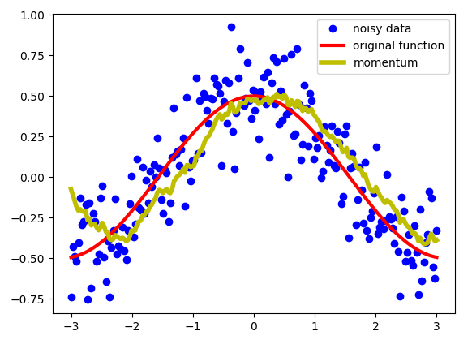
SGD + Momentum
Adds velocity term → accumulates gradient direction over time.
Helps escape local minima and reduce oscillations.
Faster convergence than plain SGD in deep networks.
Still needs hyperparameter tuning (momentum coef ~0.9).
Can overshoot if learning rate is too high.
Doesn’t adapt learning rate per parameter.

Slide 14
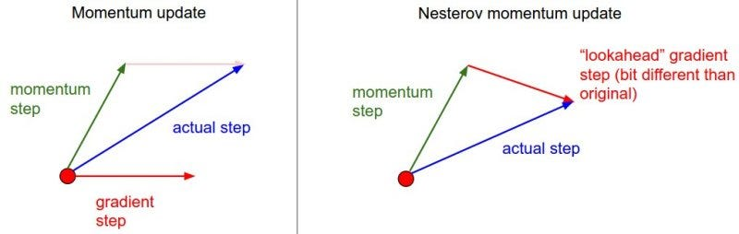
Nesterov Momentum (Nesterov Accelerated Gradient - NAG)
A variant of momentum optimization that looks ahead before calculating the gradient.
Instead of computing gradients at the current parameters, it computes them at the anticipated future position.
The update rule includes a correction step, making it more responsive to changes in the gradient direction.
Helps reduce overshooting and improves stability vs classical momentum.
Converges faster than standard momentum in many deep learning problems.
Better performance in ravines and curved loss surfaces due to more informed updates.
Considered a more accurate velocity update, since it knows where momentum is pushing before stepping there.

Slide 15
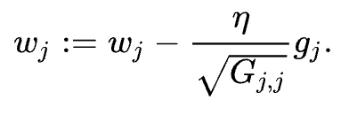
AdaGrad
Adapts learning rate individually per parameter.
Excellent for sparse features (e.g., NLP, embeddings).
Larger updates for rare features → faster learning early.
But learning rate decays continuously → training can stop.
Not ideal for long training epochs.
Mainly historical foundation for better adaptive optimizers.

Slide 16
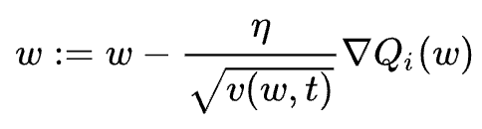
Ada Delta & RMS Prop
AdaDelta
Fixes AdaGrad learning decay using moving window of gradient history.
No manual base learning rate needed → more stable.
Good for noisy gradients and RNNs historically.
Improvement over AdaGrad but mostly outdated now.
Can be slower than Adam on modern deep nets.
RMS Prop
Adaptive learning rate like AdaGrad without total decay.
Maintains exponentially decaying average of squared gradients.
Excellent for non-stationary or noisy problems (RNNs, RL).
Usually faster convergence than AdaGrad/AdaDelta.
Still sensitive to learning rate hyperparameter.

Slide 17
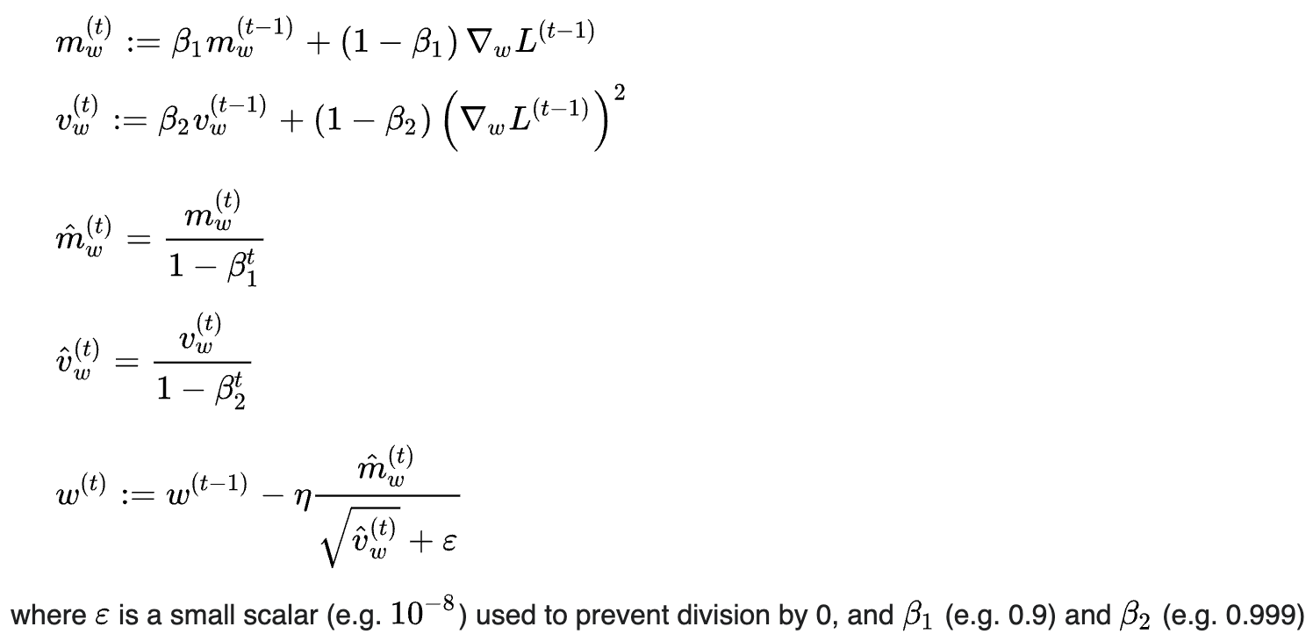
Adam (Adaptive Moment Estimation)
Combines Momentum + RMSProp → best speed + stability.
Adaptive learning rate per parameter → robust performance.
Most popular default optimizer for deep models.
Works well out-of-the-box with minimal tuning.
Weight decay and LR scheduling improve performance.

Slide 18
Graphical View : Optimzers

